Slide 1


Greenpeace Aotearoa Incorporated and
Kiwis Against Seabed Mining

Slide 2
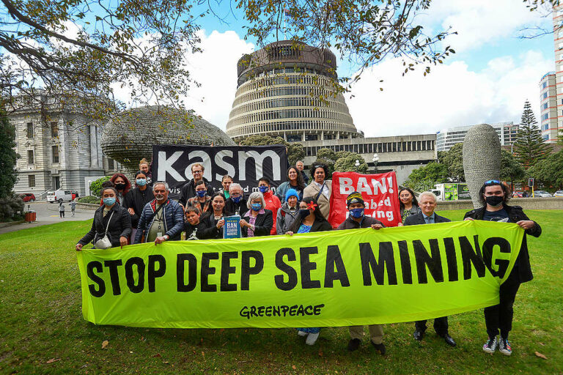
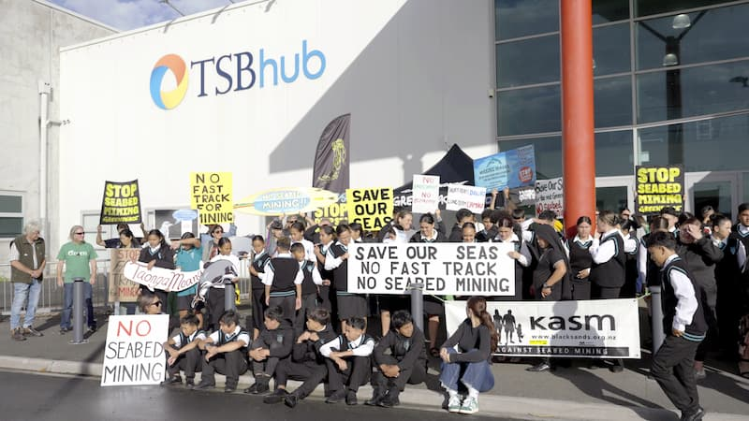
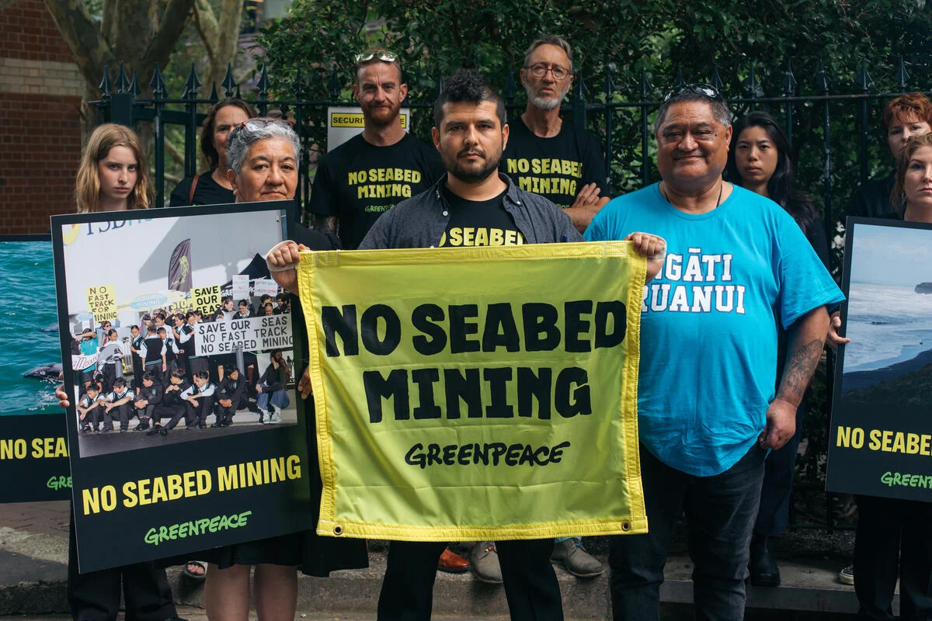
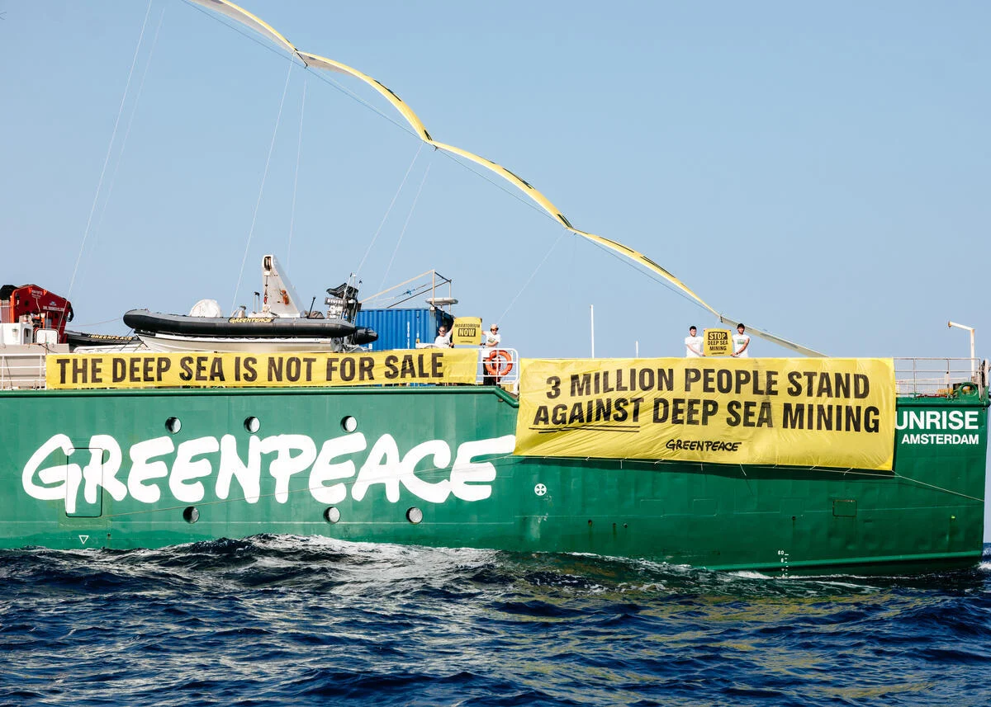
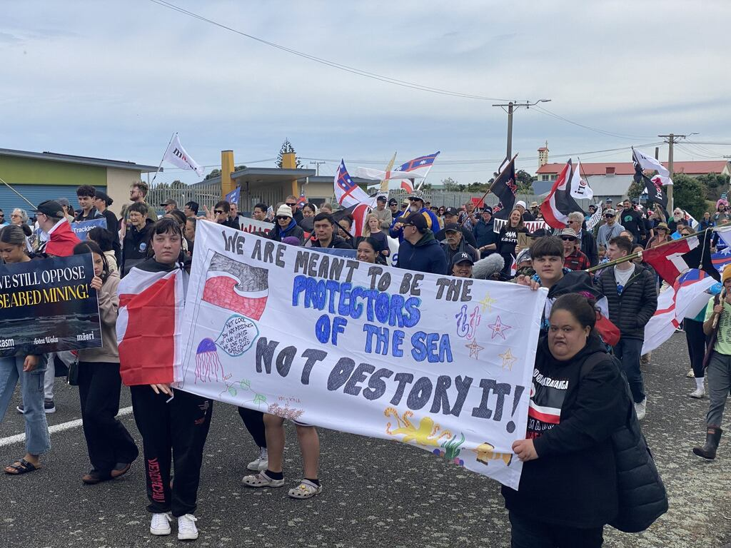

Slide 3
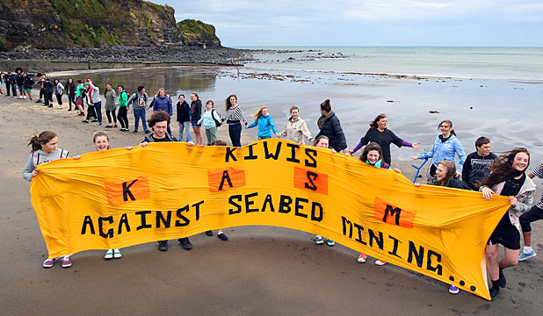
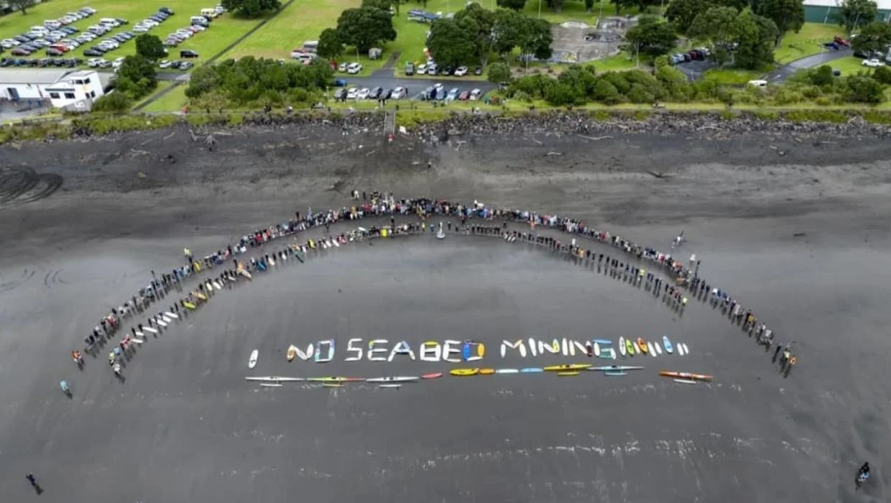
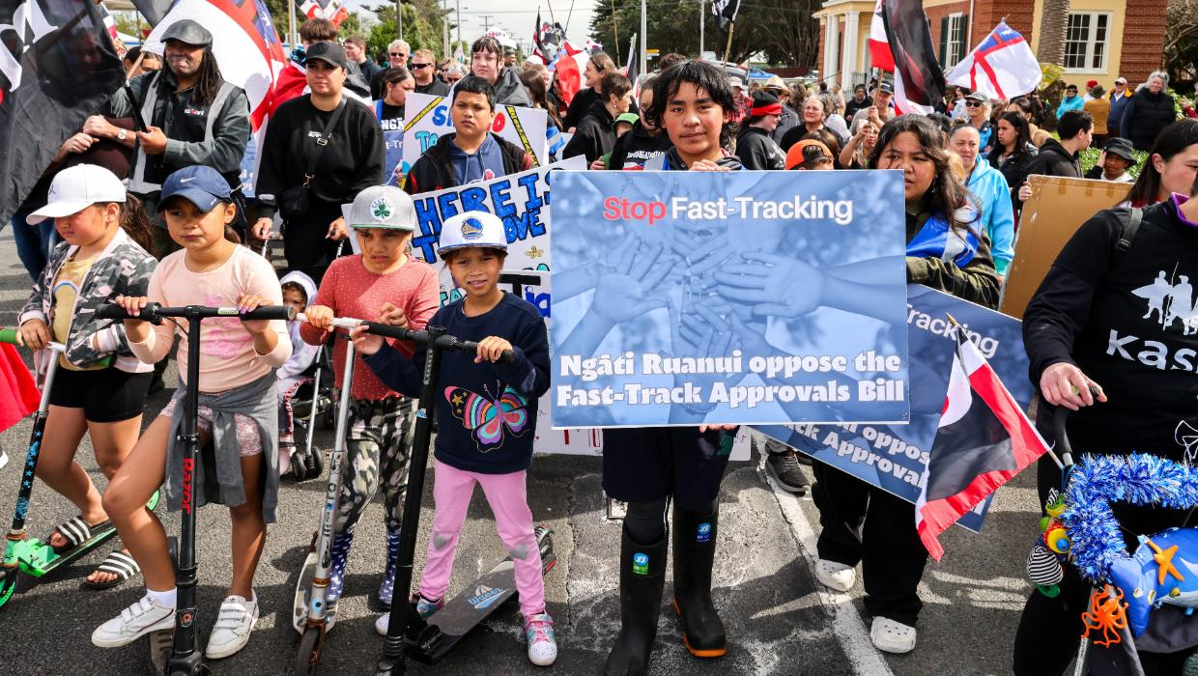
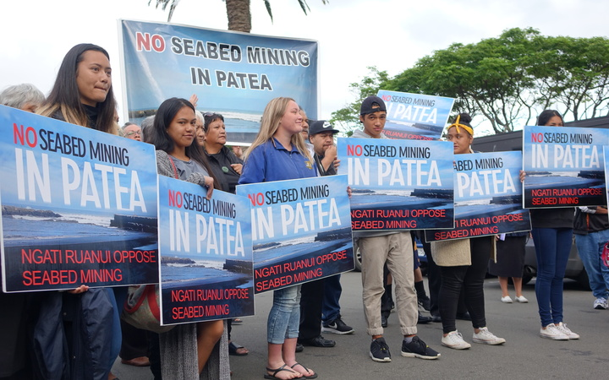

Slide 4
Operations and Economics
Application fails to demonstrate significant regional or national benefits:
Dr Chris Fleming and Andrew Buckwell economic evidence:
TTR analysis considers gross but not net benefit.
Insufficient assessment - omists costs and risks.
Overestimated the benefits.
Operational feasibility: Jill Cooper statement of evidence .

Slide 5
Sufficiently significant and out of proportion
Weighing exercise under schedule 10, clause 6 and s85(3) the same.
FTAA given greatest weight
Bottomlines should be given significant weight.
Adverse effects are so significant and out of proportion with the benefits.
Panel has residual discretion to decline.
Once threshold established, bottomlines provide determinative direction, considering overall adverse effects (not inconsistency alone s85(4)).

Slide 6
Best Available Information?
No new modelling on plume
No baseline data on seabirds or marine mammals (despite Supreme Court findings)
No further noise modelling.
No further assessment of rocky reefs systems beyond Morrison (2022)

Slide 7
same proposal, new application
Joint witness statements as starting points.
2017 DMC decision and Supreme Court’s findings highly relevant and should be given significant weight.

Slide 8
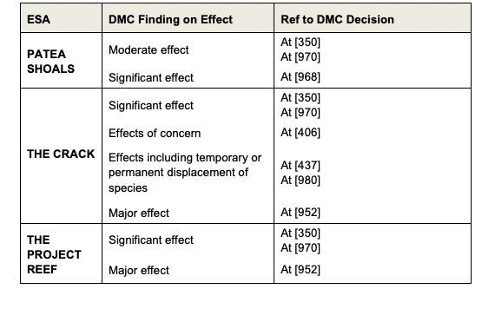
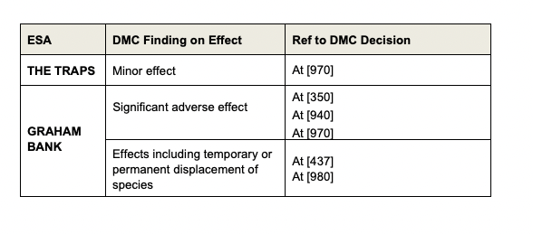
Appendx 3,
2021 NZSC [121]

Slide 9
Plume modelling: Dougal Greer
  Greer: Modelling is only as good as the inputs.
Some of the key concern with inputs:
wave period
calibration (the “99th” percentile)
3 input samples sediment
Neither the plume model nor the worst-case model is fit for purpose.
Worst Case is not Worst case.
No assessment of salinity.
Luick: flocculation uncertain.

Slide 10
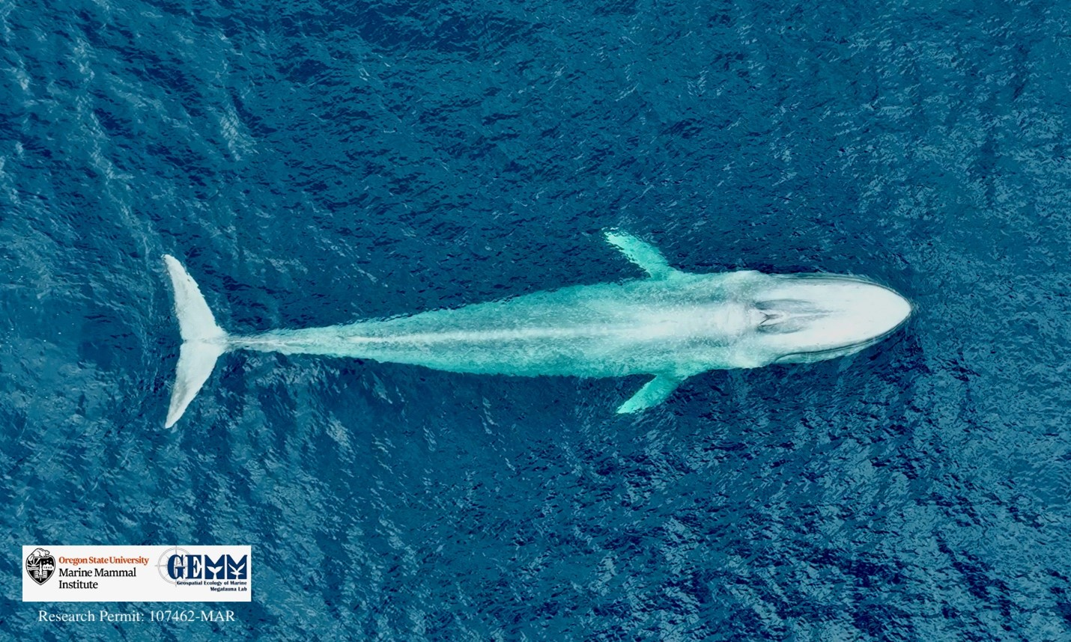
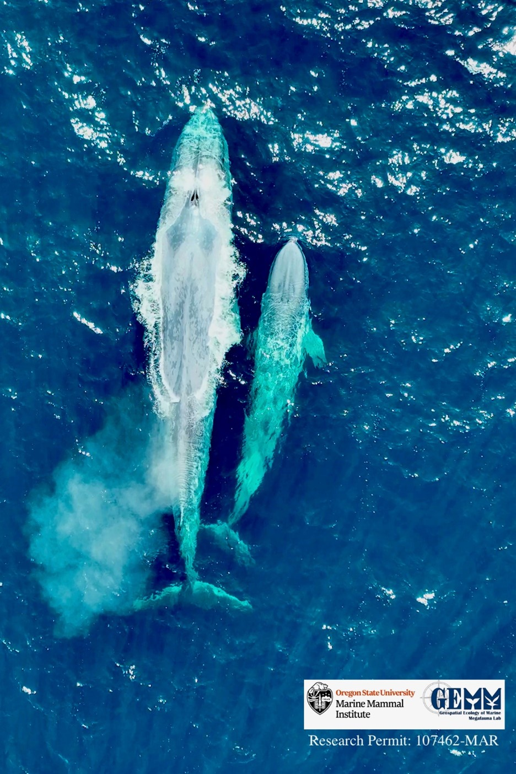
Marine Mammals: Dr Leigh Torres

Slide 11
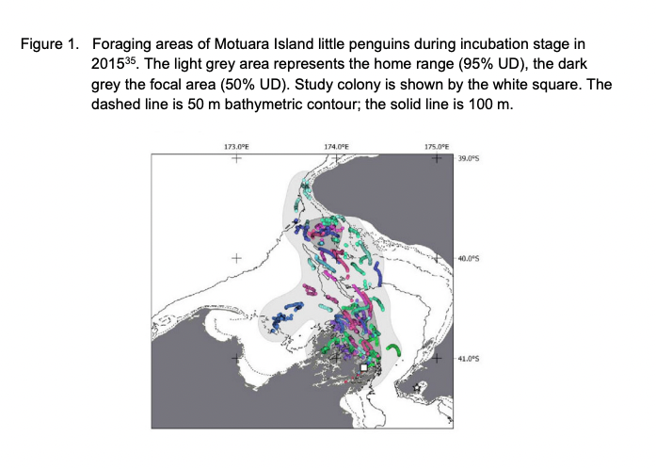
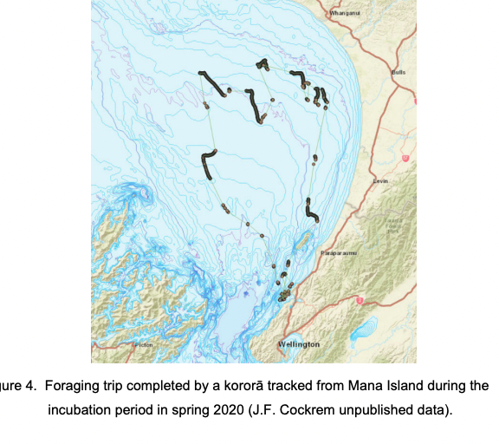
Seabirds: John Cockrem

Slide 12
Benthic Ecology
Morrison et al- Niwa Report (2022)
This report demonstrates that subtidal reefs are in fact common on Pātea Bank, with many more awaiting discovery by multibeam sonar mapping.
The application states that “at this stage there is no indication that rocky reefs occur on the Pātea Shoals seaward of the Territorial Sea Boundary”.
Dr Tara Anderson
  Responded to the evidence of Dr Alison Macdiarmid
  Summary in her evidence at [21]-[26]

