Slide 1
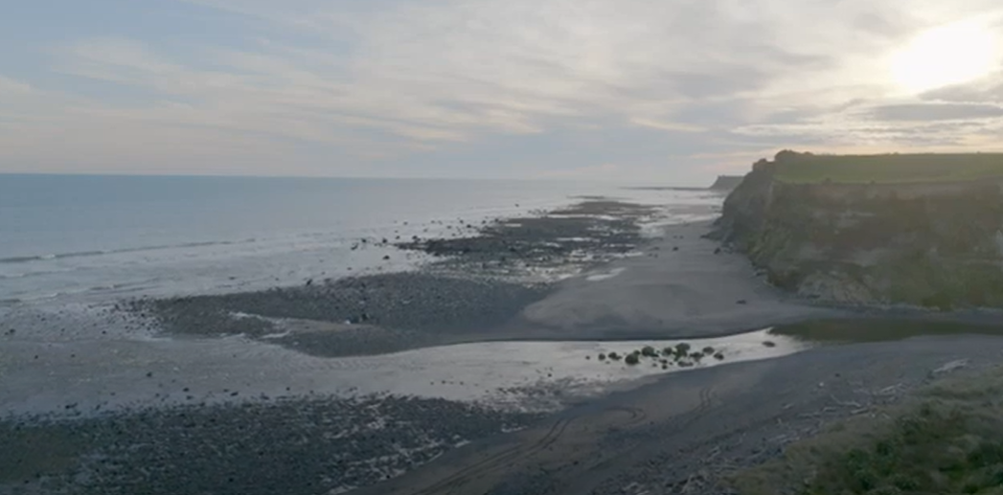

Wānanga ki Te Hāwera E pā ana ki TTR kei roto i te Fast-track
Te rā Tirea o te Maramataka. Rāpare 23 Oketopa 2025

Slide 2

Karakia
Teretere te Ika
He ika waka mou kaha hai
Tena te Ika ka moe
Ko te ika o te rua
Ko te ika o te one
Te ika o te hohonu
Tena te ika ka taki ki mua
Ka taki ki roto
Ka taki ki te turanga
Ka taki ki te kainga
Ka taki ki te au tapu nui o Tane
Ki te au tapu nui o Tangaroa

Slide 3
Karakia
The swimming fish
The first fish caught
Behold the fish killed
The fish of the deep hole
The fish of the bank
The fish of the deep
Behold the fish is drawn before
Is drawn to the side
Is drawn to the landing
Is drawn to the village
Is drawn to the sacred current of Tane
To the abode of Tangaroa
(Rangatapu karakia used for the successful return of a fishing expedition)

Slide 4
Appearing for Ōkahu Inuāwai me ētehi atu Hapū:
Ms Marylinda (Mere) Ngāti - Kawhena te Kaho Brooks
Nanny & Kuia
Registered Nurse
Masters Primary Health Care
PostgradDipEd
Mr John Henry Te Urikore Katene Hooker
BAgrSc.NZIValuers(ProfQuals)
Rangakura DipTchgPrimaryBilingualBicultural.Bed
Te Tohu Matauranga Whakapakari Tino Rangatiratanga O Te Kohanga Reo
Environment Commissioner 2025
Ms Alison Anitawaru Cole
BA Law (First Class Hons) Cambridge University
LLM (Human Rights Fellow) Harvard Law School
PhD Victoria University Wellington & Masters in Planning Lincoln (2026)
Admitted to practice law in New Zealand, New York, UK
Environmental Commissioner 2025
Notes:
JOHN: To introduce our hapū and ourselves, please refer to our written comments.

Slide 5
Overview
Whakapapa
Procedure & necessity for hearings
Our comments & relevant matters
Answers to panel pātai
Formally lodge Taiao Plan
& Climate Strategy

Slide 6
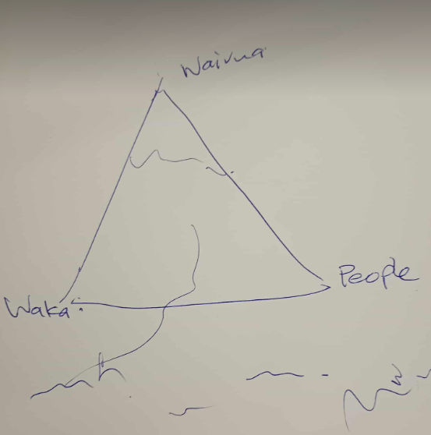
Whakapapa

Slide 7
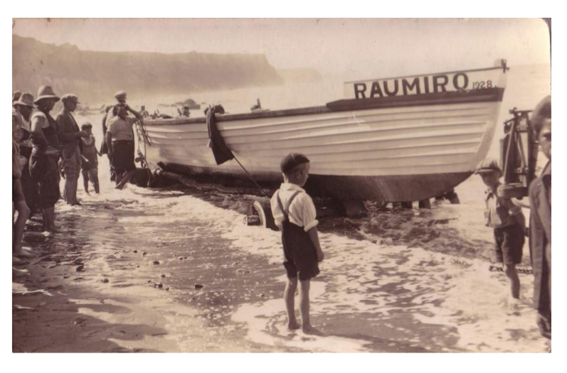
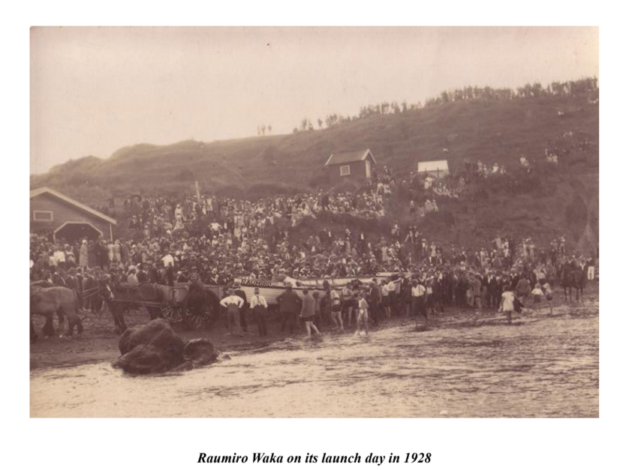
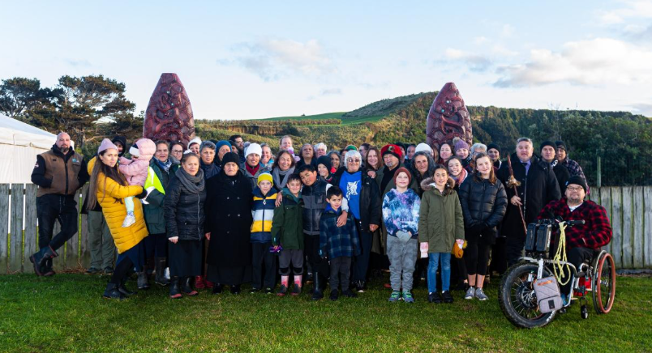

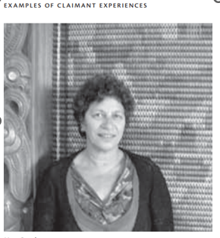
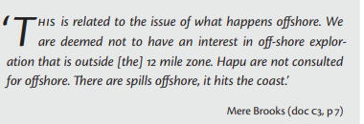
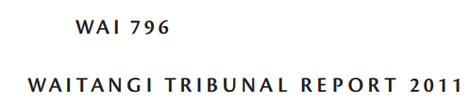

Slide 8
Procedure
Pause proceedings for pre-lodgement consultation & engagement
Marae & site visits
CIA commissioned from each hapū
Appointment of experts
Hearings at ngā marae o Aotea waka
6 ) Confidentiality protocols e.g. aka wāhi tapu

Slide 9
Our comments & relevant matters
Whakapapa to Tangaroa
Waiū to Maunga Taranaki
Tikanga defined under our own mana motuhake
Tikanga & legal personhood means TTR would cause grevious bodily harm to living tūpuna
“Benefit”includes
tikanga understandings of benefits & costs
kaitiakitanga & tikanga-based wai ora
pātaka-based intergenerational economy

Slide 10
Pātai #1 Settlements & tikanga
Tauranga waka legal title
Statutory acknowledgements on moana
Coastal strip from Waihi ki Taungatara
Awa riparian strips
$9B quantum, redress $67m 0.74%

Slide 11
Pātai #1 Settlements
Ngaruahine Fisheries Settlement
2015 Ngaruahine Settlement Act
Taranaki Maori Trust Board Act update
Taranaki Maunga Settlement

Slide 12
Pātai #2 Rangatiratanga, Kaitiakitanga & Mauri
Mana motuhake mō Papatūānuku, mō taku Tangaroa.
Mana moana control on behaviour to protect the moana – for example
community education via public wānanga
sharing mātauranga (as appropriate) via wānanga
Rāhui under tikanga including on commercial operations out at sea and coastal rāhui under tikanga with public signs for over 15 years.
Kaitiakitanga also nuturing our tupua, our taniwha, our mauri.
Tauranga waka and tauranga ika and mauri stones.
Karakia and karanga.
Pātaka economy from sharing kaimoana & investing in waka.

Slide 13
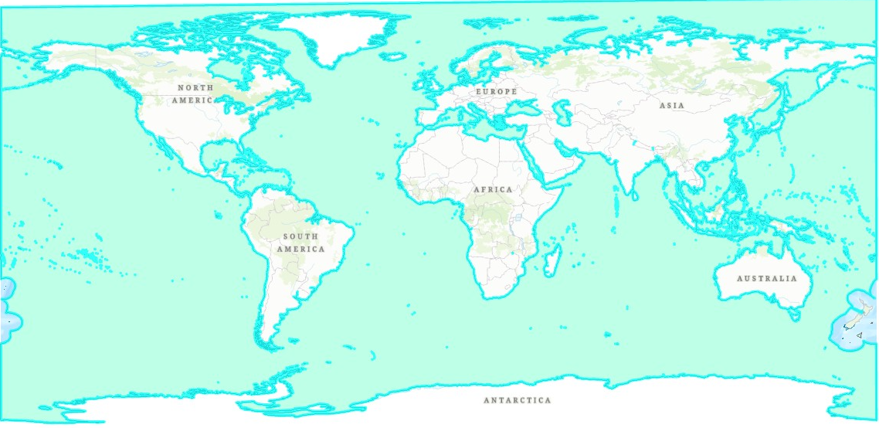
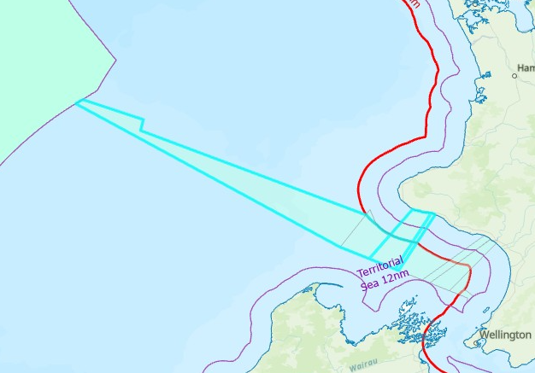
Pātai #3 Shared Spaces
Mai te ngutu awa o Waihi (Pukeoha)
Ki Hawaikinui, Hawaikiroa, Hawaikipamamao
Ki te ngutu awa o Taungatara
Ki te Rāwhiti ko Ngāti Ruanui / Tangahoe.
Ki te Uru ko Taranaki.

Slide 14
Pātai #4 Outer EEZ & beyond
Pīho (trading)
From Pātea/Waingongoro to Rangitoto (D’Urville Island)
From Pātea & 5-Mile Reef trading for argillte
From Waingongoro & Taranaki to Te Taipoutini for pounamu
Manu
Tītī (mutton bird) – Okahu-Tītī Pā & Mangaōtuku (Toko & Whangamomona)
Kawau (shag) – Kawau Pā
Toroa (albatross) – hononga with Parihaka & Tohu whangai
Ika
Mako – kaitiaki
Tohorā – tohu for fishing
Whai – tohu for fishing
Tuna (eel) – swim to Tonga
Īnanga (whitebait) – maturity in deep ocea
Pīharau (lamprey) – companion feeding on deep water fish e.g. Mako
Marine Mammal Sanctuary & Reserve Strategy (estimated 718 endemic blue whales)

Slide 15
Pātai #5 MACA
Third reading of MACA repeal through Parliament āpōpō.
One million Māori NZ citizens loose property rights.
Hapū currently shelved MACA HC till 2029.
Ngāruahine hapū at no stage have ever relinquished mana motuhake o taku Tangaroa.

Slide 16
Pātai #6 Kaimoana Customary Fisheries
Each Ngāruahine hapū has Kaimoana Regulation 50 (K-Regs)Tangata Kaitiaki.
Section 186A application
Form 1 rohe moana & kaitiaki: Hawaiki nui, Hawaiki roa, Hawaiki pāmamao
Mātaitai application strategy

Slide 17
Pātai #7 Customary authorisations & rāhui
Rāhui are significant living cultural practises in Ngaruahine
Rāhui regularly in Moana, Whenua, Maunga

Slide 18
Pātai #7 Customary authorisations & rāhui
Rāhui Moana
at least 20 have operated in the last 51 years Fidelis boat sinking off Rangatapu 5 lost
2024 One person fell off cliff Rangatapu brief period Karakia/ruruku

Slide 19
Pātai #7 Customary authorisations & rāhui
Rāhui Whenua
1999 Winks Road Rahui Hapu/uri vs PKW
2021 Rahui Oeo School/Official Assignee returned 2022
Rāhui Maunga
1 Oct 2025 Missing climber on Te Rehua/Te Iringa, lifted 5 Oct at Ngutuawa Kapuni
Last 5 years have completed 2 other rahui for mate at Te Pou O Ngaruahine

Slide 20
Pātai #8 Customary Practises
Tapu:
Ruruku blessings
offshore rigs
Kupe
Maari

Slide 21
Pātai #8 Customary Practises
Noa:
Customary catch for deep sea pātaka
Tangihanga
Special iwi / hapū events

Slide 22
Pātai #9-13 Te Tai Hauāuru & Effects
Tautoko fellow submitters for hapū, iwi & NGOs

Slide 23
Pātai #14 Commercial Interface Moana Users
Fonterra Hawera discharge to Moana
STDC discharge to Moana
Windfarmers (3)
NOT TTR

Slide 24
Pātai #5 Governance & conditions
No conditions sufficient to address harm.

