Slide 1




Taranaki Offshore Partnership Before the Taranaki VTM Expert Panel
21 October 2025

Slide 2
Overview of TOP’s case (Legal Submissions)
TTRL’s Proposal will result in significant adverse impacts on the South Taranaki Bight (STB), including effects on the geotechnical characteristics of the seabed, seabed morphology, and waves and currents.
The adverse impacts will:
Occur within and outside the mining area; and
Persist long after the mining has concluded.
Those adverse environmental impacts will prevent or constrain use and development of the South Taranaki Bight, which includes NZ’s premier site for offshore wind generation.
TTRL has significantly overstated the economic benefits of the Proposal.
TTRL has failed to account for the Proposal’s significant adverse economic costs - including the opportunity cost for offshore wind generation.
TTRL has not presented the “best available information” in its application.
Overall, the adverse impacts of TTRL’s proposal are sufficiently significant to be out of proportion with the benefits. The Panel should exercise its discretion to decline the application.
TTRL’s legal submissions say that the issues raised by TOP can all be disregarded. That is not correct. TOP’s submission raises legitimate geomorphology effects on the environment of the South Taranaki Bight.
Those effects and the flow on impacts identified by TOP are real, significant and cannot be disregarded. TTRL’s proposal will impact the energy security options for all New Zealanders for generations to come.

Slide 3
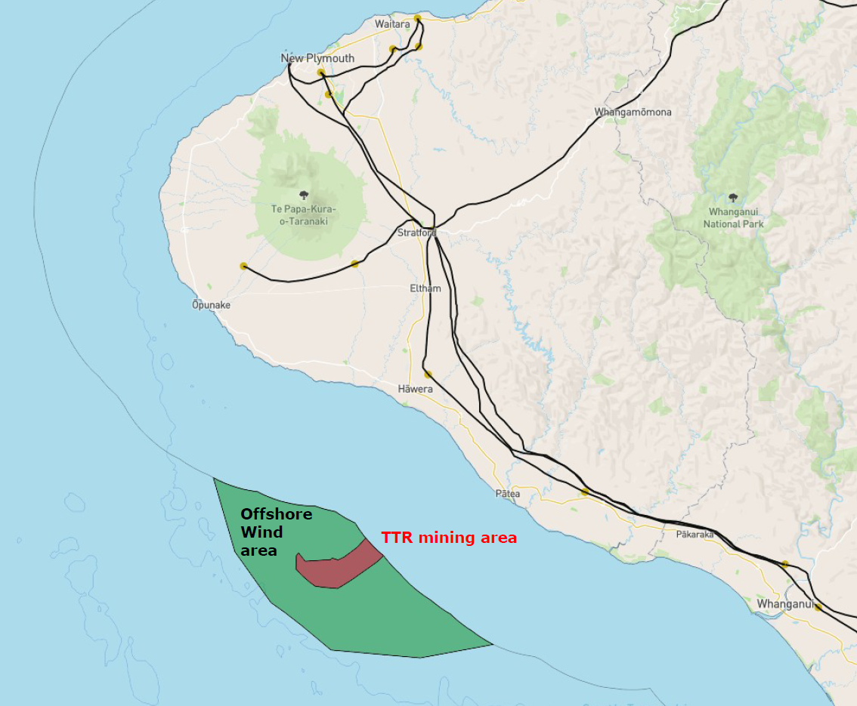
Introduction to TOP (Evidence of Mr Caleffi)
A 50/50 joint venture between NZ Super Fund and Copenhagen Infrastructure Partners.
The STB is by far the best location for the establishment of offshore wind in New Zealand, due its strong winds, shallow waters and proximity to the National Grid.
TOP’s proposed offshore wind project comprises a 1GW (approximately 70 wind turbines) offshore wind farm.
Subject to the final drafting of the Offshore Renewable Energy Bill, TOP intends to apply for a feasibility permit as soon as the Bill passes and the first permit round opens (Government commitment: early 2026).
TTRL’s Proposal area is located right in the middle of the STB’s premiere wind resource area and TOP’s areas of interest.
If marine consent is granted for TTRL’s Proposal, it will negatively affect the prospect of any future offshore wind development in the STB.

Slide 4
Seabed morphology impacts (Evidence of Dr McComb)
TTRL’s Proposal will significantly impact seabed morphology through the creation of significant and effectively permanent ‘pits’ and ‘mounds’ of unconsolidated material on the seabed.
TTRL’s modelling of those impacts is flawed. Mounds created by mining are likely to be much larger than estimated. TTRL’s response relies on conditions limiting those modifications, but it is unclear if/how TTRL will modify mining activities to achieve those limits.
TTRL expects the pits created by mining to migrate, but it has not analyzed the extent of migration. TTRL’s response does not resolve this issue.
Changes to seabed morphology will alter:
Wave patterns: which could create localised navigational hazards.
Current speeds: failure to consider could impact modelling of other impacts eg mound deflation.
TTRL’s response does not resolve these issues.
The seabed morphology impacts will be enduring:
TTRL’s modelling of pit infilling and mound deflation rates contains several errors.
In shallow areas, natural remediation will be at least 5x longer than predicted.
In deeper areas, natural remediation will not be effective, and changes to the morphology will be essentially permanent.
TTRL’s response does not resolve these issues.

Slide 5
Geotechnical impacts (Evidence of Mr King)
The Proposal is expected to:
Significantly reduce geotechnical strength and density of the upper seabed;
Increase the risk of settlement;
Increase the risk of seabed liquefaction and seabed instability; and
Make all existing surface mapping obsolete and remove the ability to reliably map natural features and geo-hazards.
Those impacts will have direct implications for future uses of the seabed both within and for an uncertain distance outside the mining area, that rely on natural seabed state.
Impacts on Offshore Wind (Evidence of Mr Perry)
A detailed understanding of seabed conditions is required to progress design refinement of offshore wind farm foundations, cables and supporting infrastructure. The Proposal will introduce high levels of uncertainty regarding seabed conditions (as per TOP’s expert evidence) which will substantially increase the costs of investigating/developing an offshore wind farm and increase technical design risk.
The concurrent construction and/or operation of an offshore wind farm and seabed mining in the same broad area of seabed would present:
Considerable navigation safety risks; and
Considerable challenges to the ability to successfully develop, fund, finance, construct and operate a commercially feasible offshore wind farm.
Those challenges are so significant that it is unlikely that a developer would pursue or be able to secure finance for an offshore wind farm impacted by seabed mining.
TTRL’s response does not substantively address the geomorphology effects as it relates to offshore wind development. It only suggests the geotechnical impacts of its mining activity will not have material implications for other activities. TTRL’s evidence does not support that conclusion. These issues remain in dispute.

Slide 6
Economic benefits and costs (Evidence of Mr Colegrave)
The Input–output (I-O) model is insufficient for a large, first-of-its-kind, capital-intensive proposal with material supply-side constraints and high delivery risk.
TTRL has overstated economic benefits because (inter alia):
Induced effects inflate the Proposal’s likely economic benefits by 22% - 29%.
The Proposal’s deliverability risk is very high.
There are unreliable inputs and assumptions.
There are optimistic labour market assumptions.
NZIER’s response largely does not address these issues. It acknowledges inputs were provided by TTRL without validation.
TTRL has understated economic costs because:
It does not consider material opportunity costs: An offshore wind farm will generate comparable or greater GDP/employment benefits as TTRL’s Proposal, and will have other benefits (e.g. substantial emissions reductions, and enduring infrastructure).
NZIER’s response acknowledges the need to account for opportunity costs. In its response NZIER has considered economic costs for tourism and fishing (although it has used an inappropriate base year of 2020 for tourism), but does not consider or reference the economic costs of offshore wind development displacement.
Conclusion: NZIER’s analysis of the purported economic benefits:
Is not reliable;
Has materially overstated the economic benefits of TTRL’s Proposal; and
Has materially understated the costs of TTRL’s Proposal.

