Slide 1

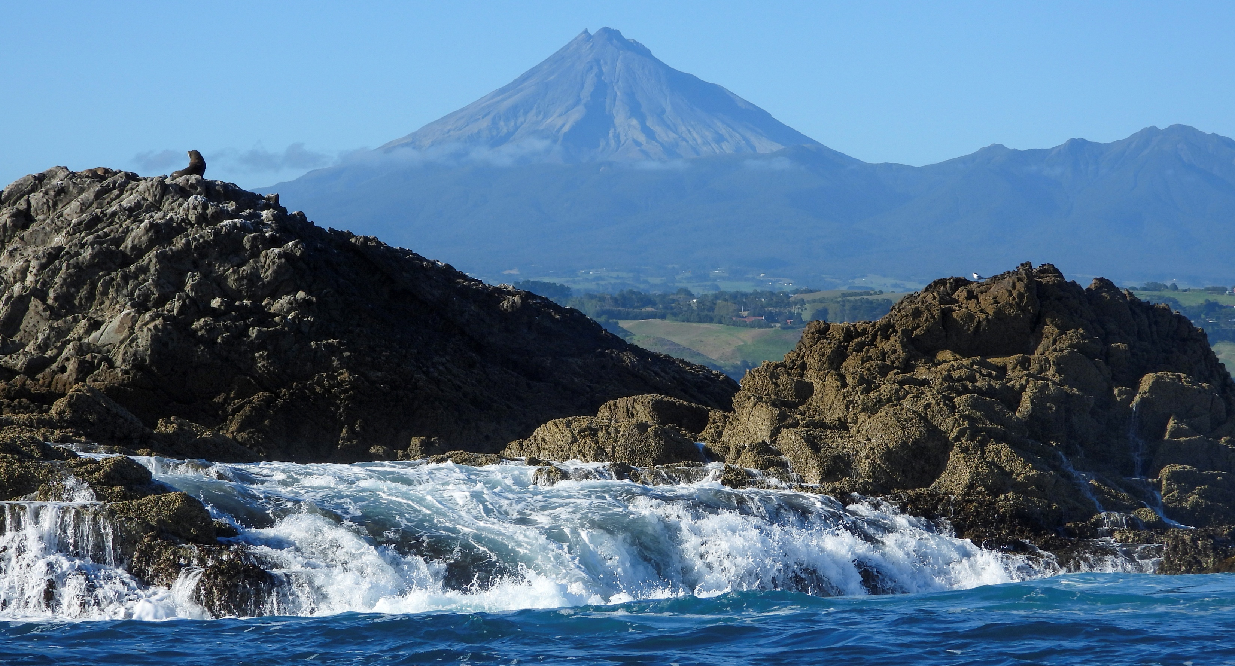
Vision
For Taranaki to have healthy marine and coastal ecosystems through science, education, community action and policy advocacy

Slide 2


We’re concerned about effects of:
Direct extraction
Sediment plume: Reduced light penetration and smothering
Over the large area affected by the sediment plume it becomes problematic to:
Identify sensitive habitats and threatened species
Adequately assess cumulative effects and the wider ecological consequences within marine food webs

Slide 3
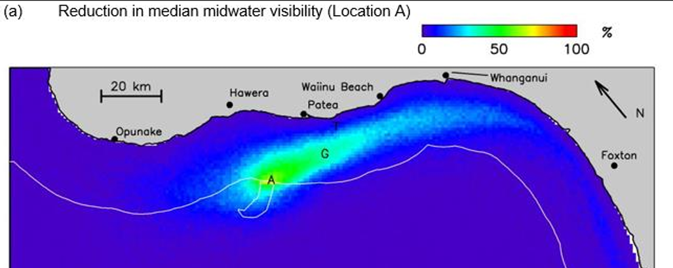
Light (Midwater Visibility)
Green = around 50% reduction
Mining @ Site A:
  Graham Bank (G) ~40% reduction ~20km away from mining site
  Plume ~704km²

Slide 4
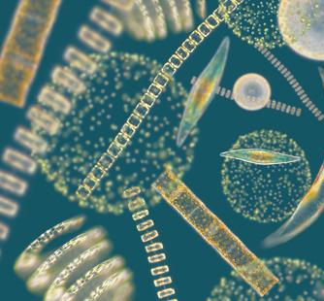
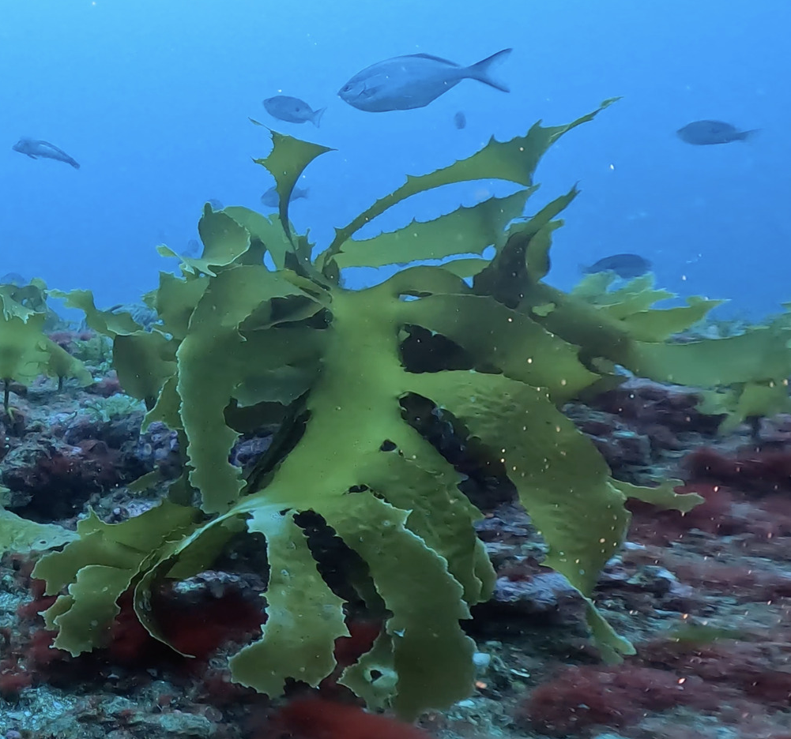
Significant Reduction in Light
Impact on Primary Producers
Phytoplankton: Base of marine food web
Seaweed: Provides valuable habitat for reef fish and invertebrates

Slide 5

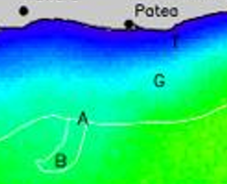
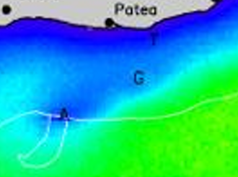

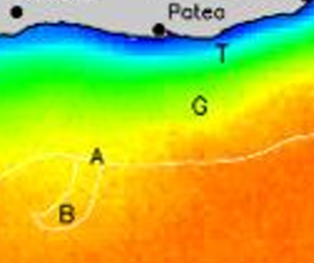
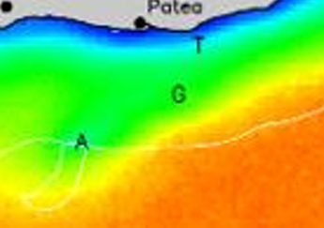
Figure 3: Light levels interpreted
Background
Site A
Background
Site A

Slide 6
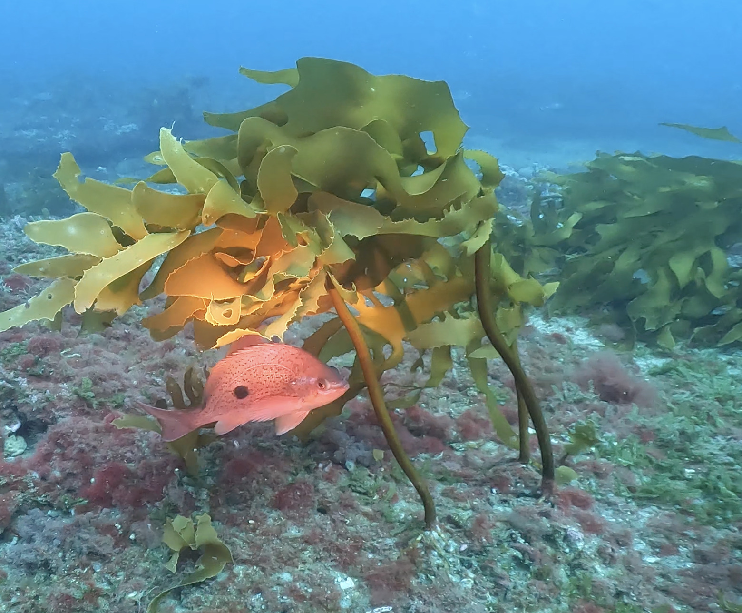
Reefs
TTRL Previous Applications:
South Taranaki Bight described: “Sandy desert”

Slide 7
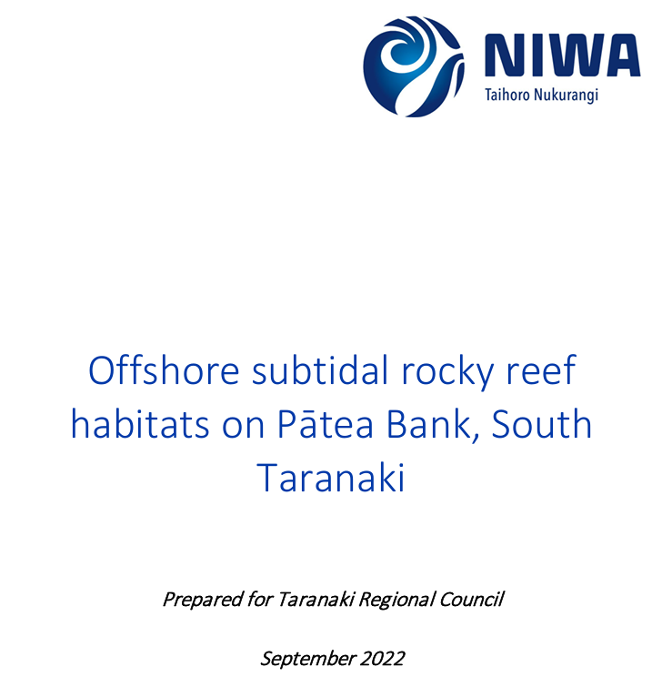
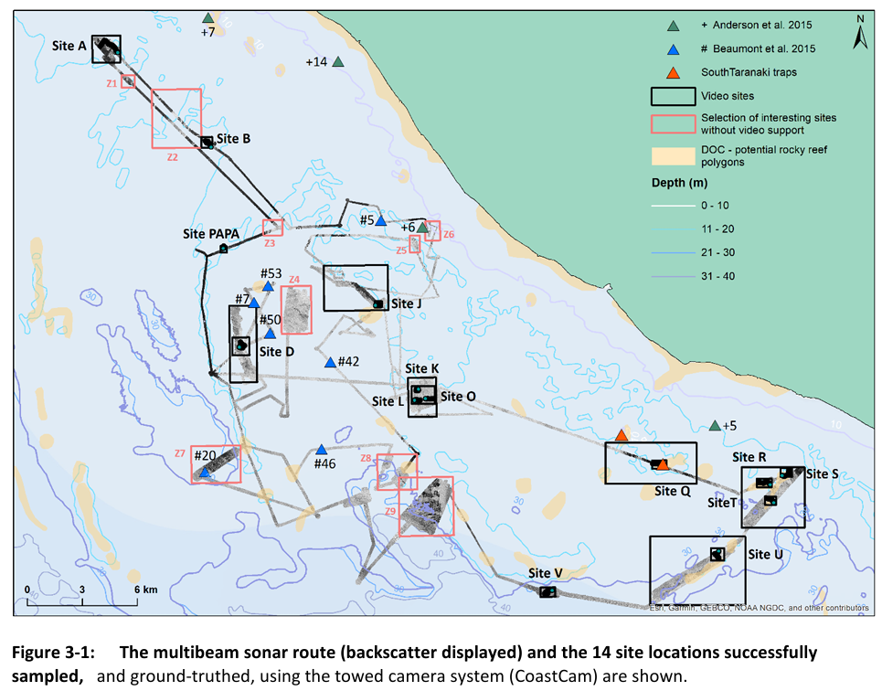
Multibeam sonar mapping
Revealed numerous reefs
Inc: Linear ridges several km long
14 reefs: studied further
Inc: Project Reef (ONC: Coastal Plan)
Pātea
Project Reef (K)

Slide 8
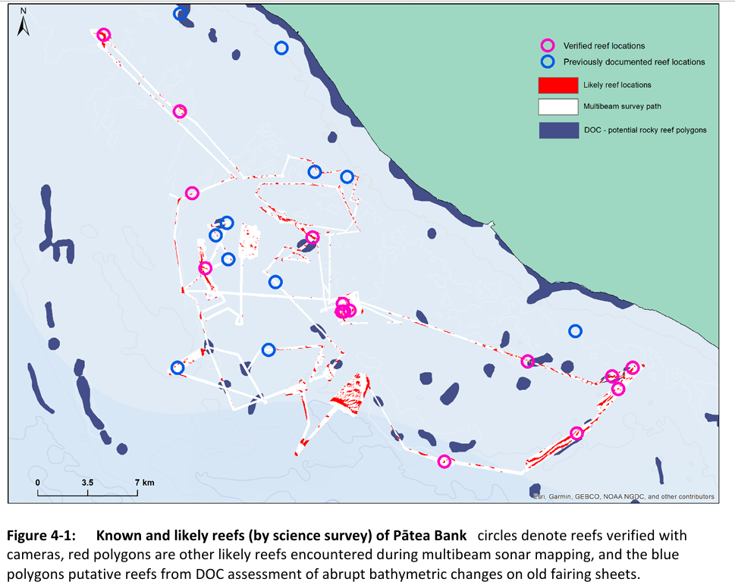
“This report demonstrates that subtidal reefs are in fact common on Pātea Bank, with many more awaiting discovery by multibeam sonar mapping.”
Pātea

Slide 9
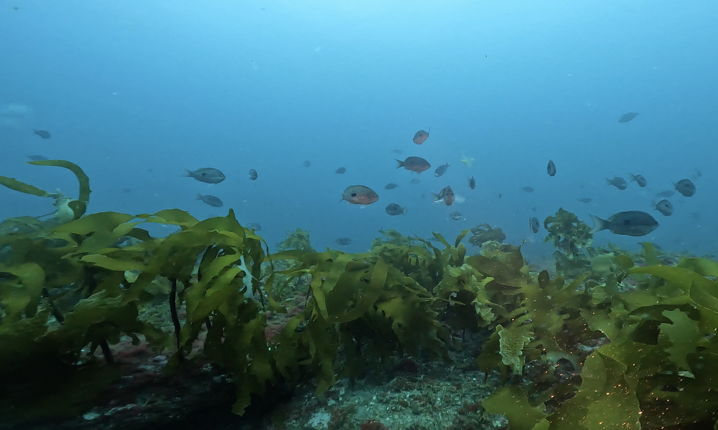
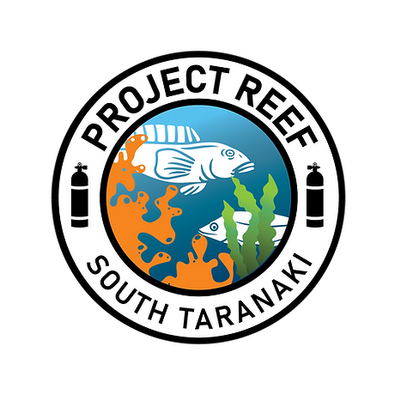
“Associated with these reefs are extensive areas of biogenic habitat, dominated by macroalgae”
Kelp forests (Ecklonia radiata):
Habitat forming seaweed
Requires sufficient light to grow
Present due to sufficient light at depth
Photo credit

Slide 10
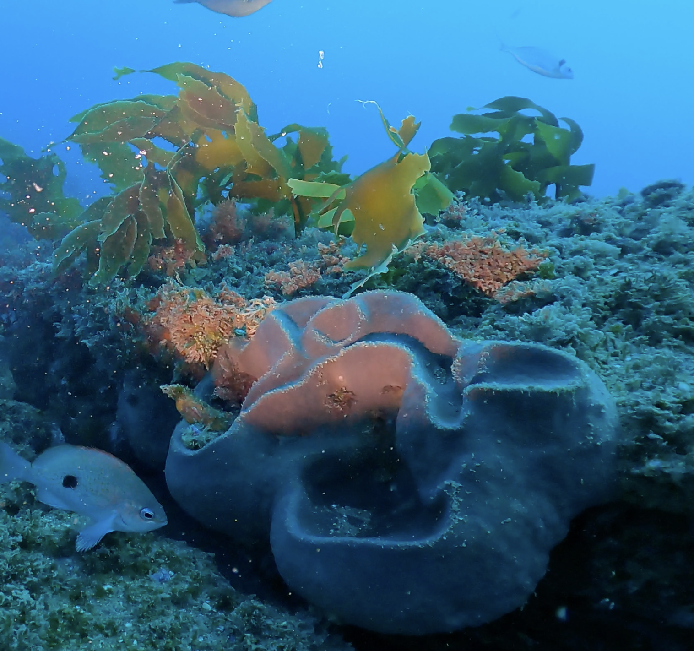
Habitats also included sponge gardens and soft bryozoan fields
Photo credit

Slide 11
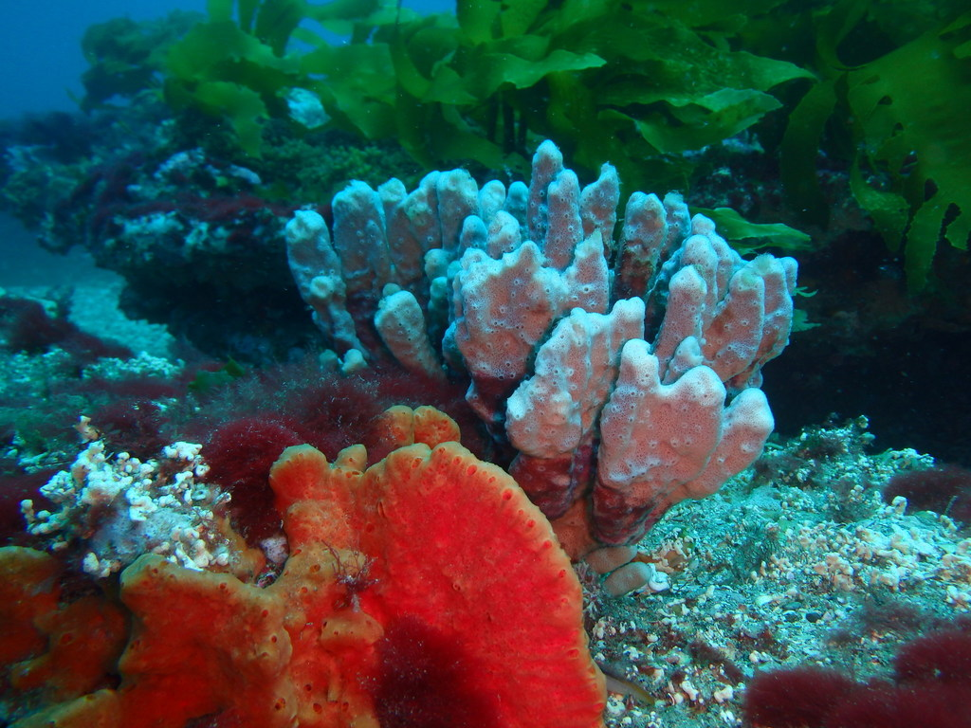
Photo credit

Slide 12
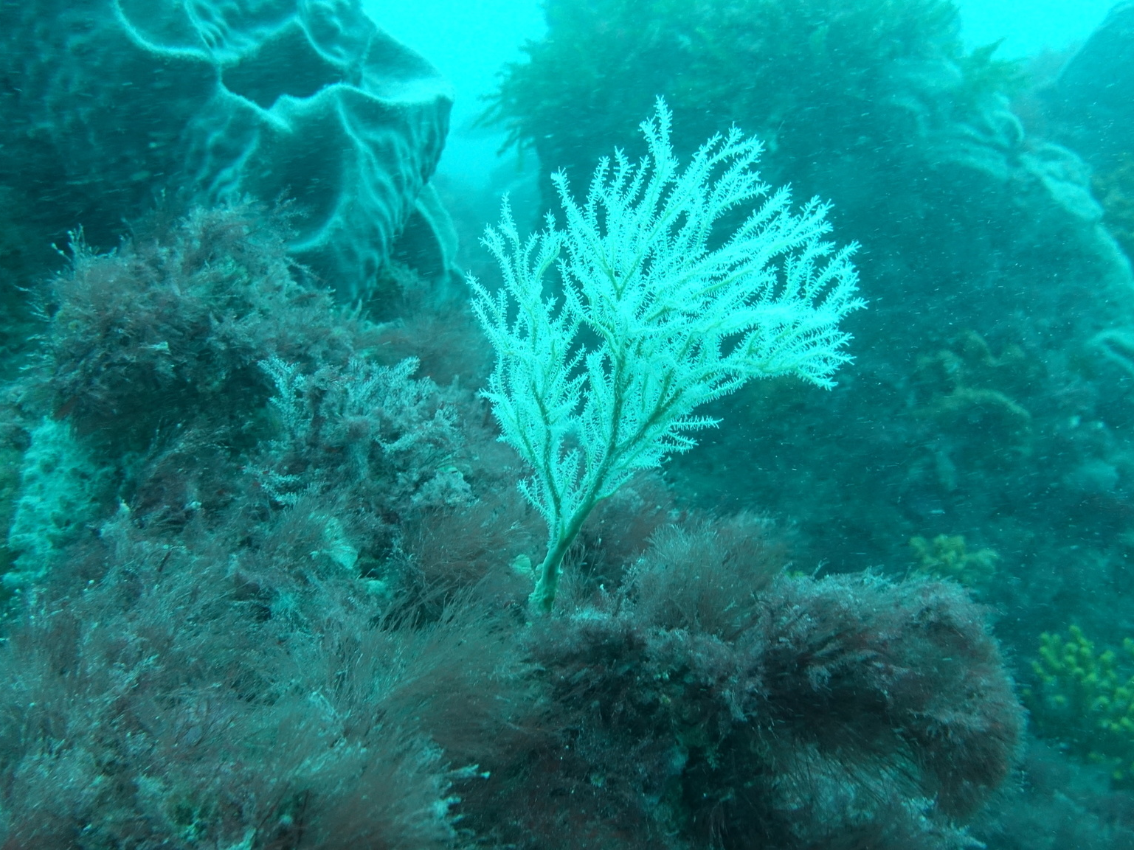
Photo credit

Slide 13
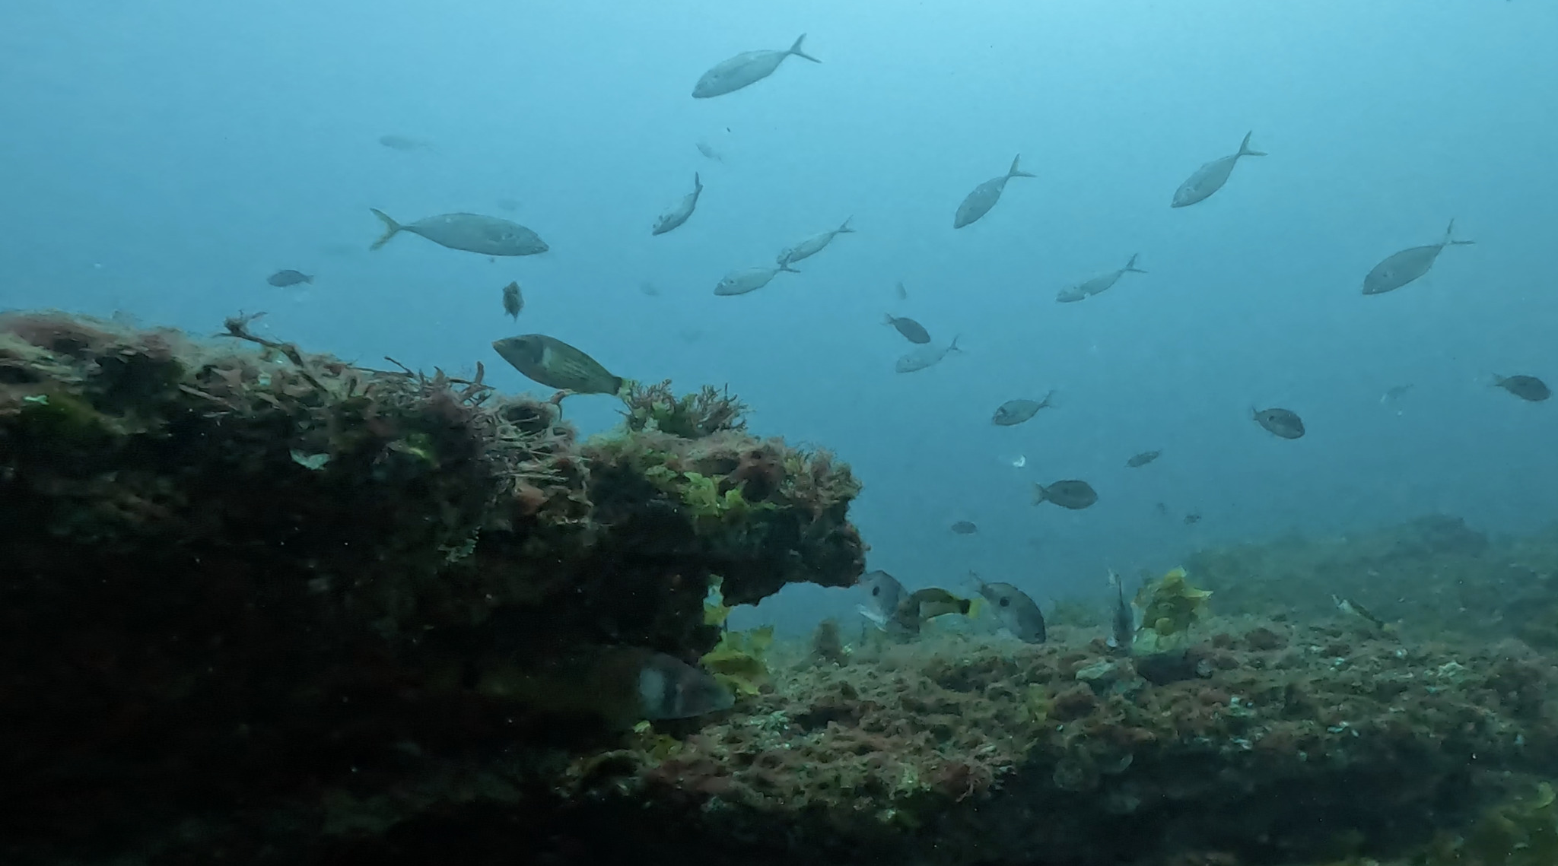
“The associated fish assemblages are abundant, dominated by blue cod, scarlet wrasse, butterfly perch, leatherjackets and tarakihi, with other fisheries species likely to be common (e.g., snapper, trevally, kingfish, and kahawai).”
Photo credit

Slide 14
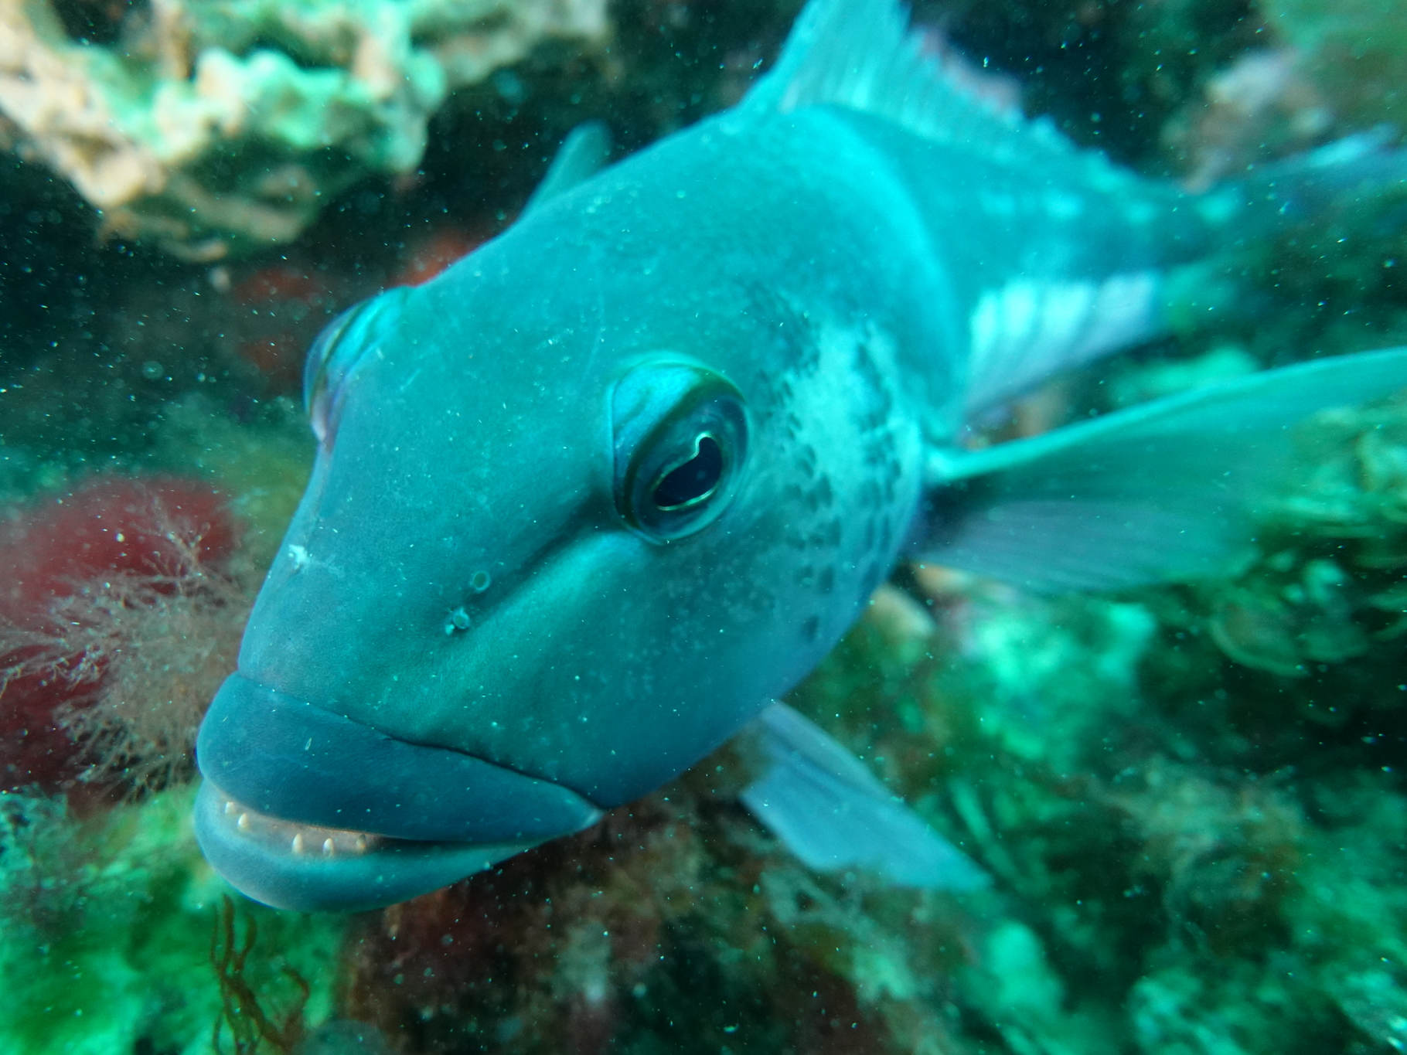
Photo credit
High densities juvenile blue cod: important nursery habitat

Slide 15
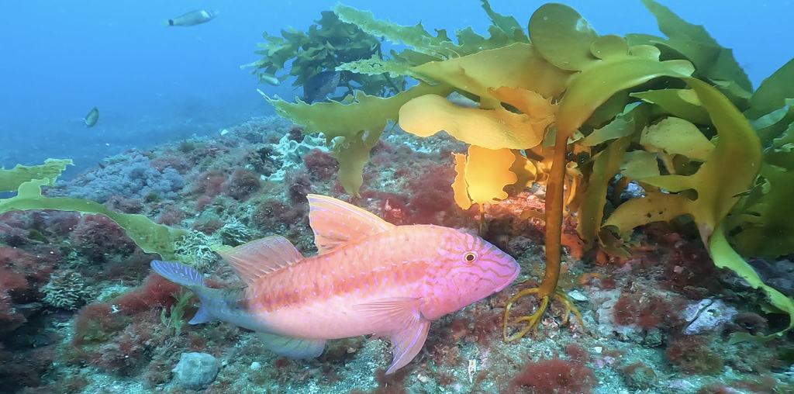
“The unusual distance of these reef systems from shore, occurring on a wide shallow continental shelf, makes them relatively unique in the New Zealand context……..
They are worthy of careful management by the TRC, and other governance entities.”
Photo credit

Slide 16
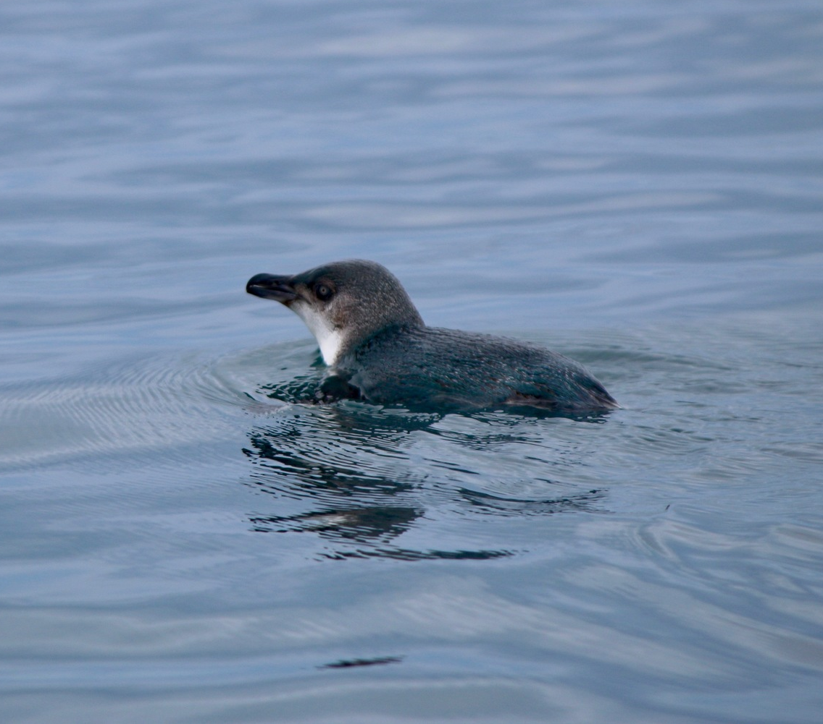



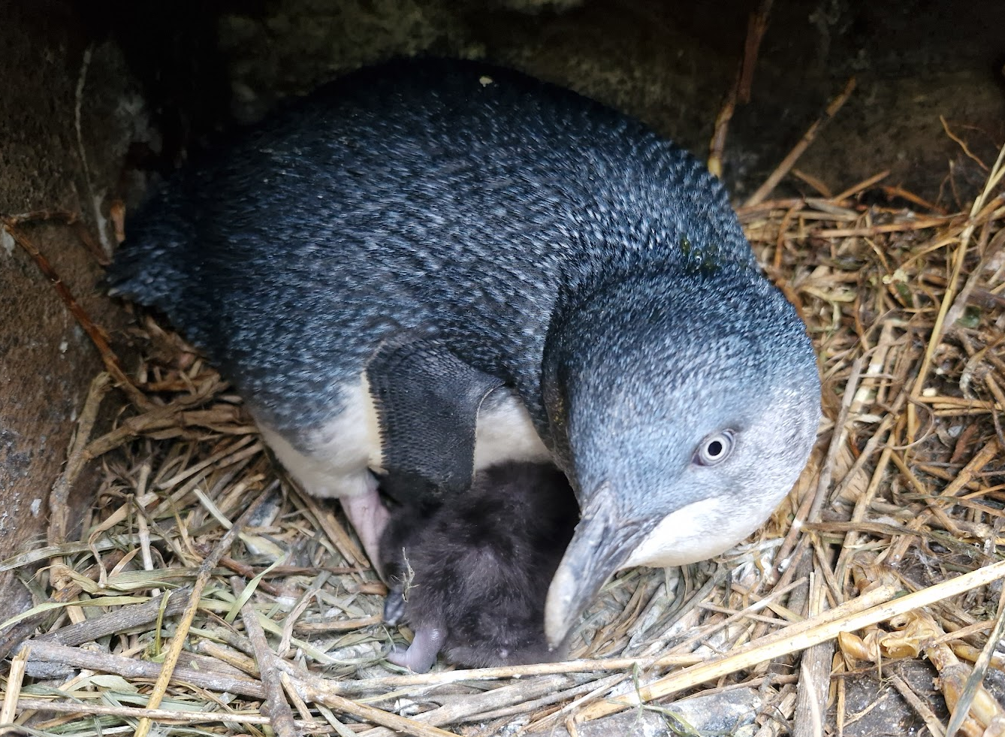
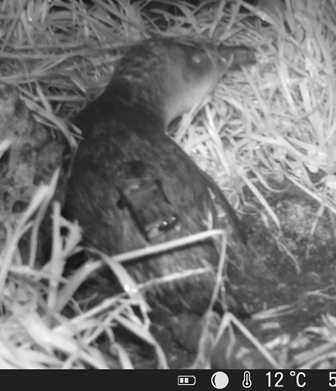
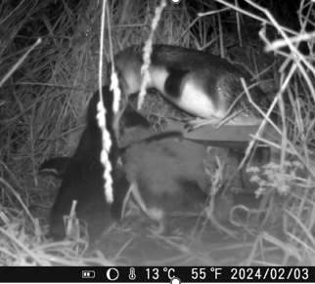
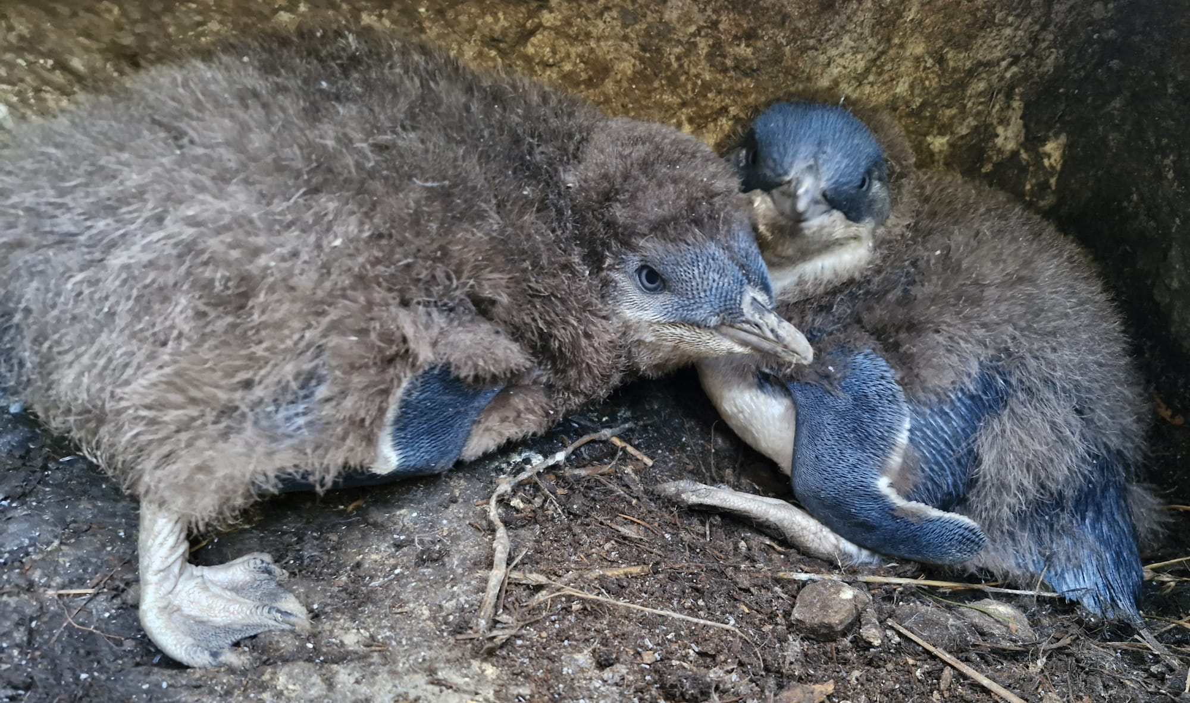
Kororā – Little blue penguins
Threat status: At Risk - Declining

Slide 17
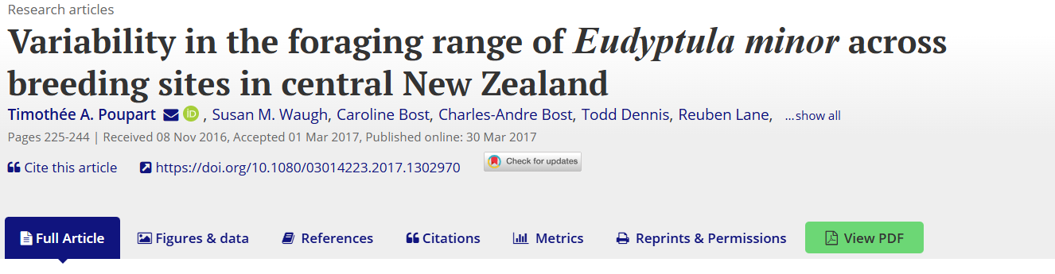
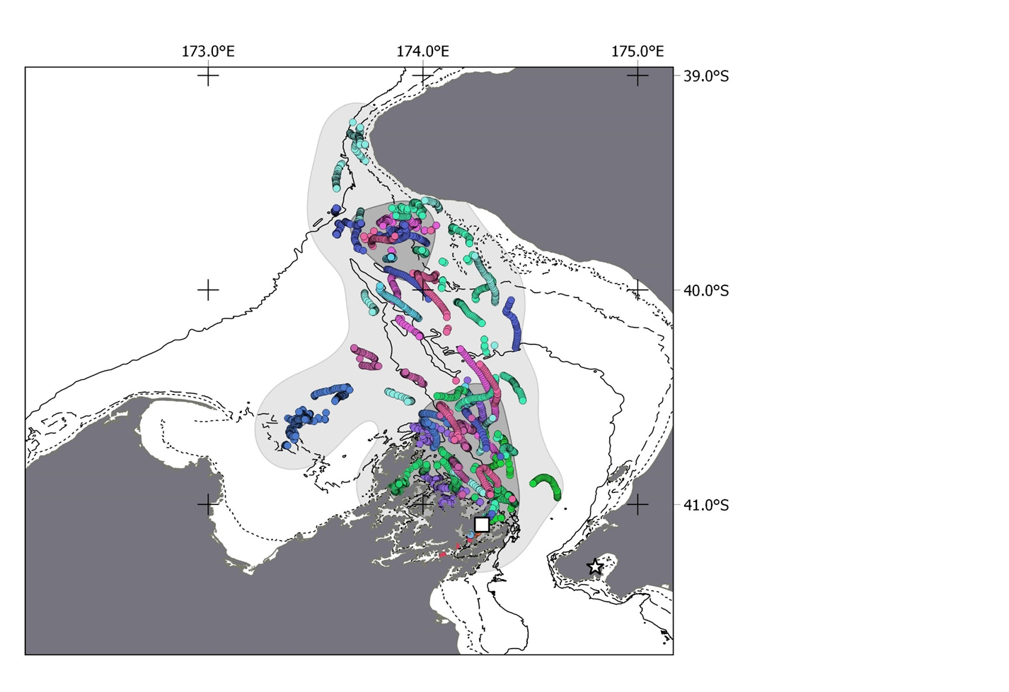
GPS trackers
Motuara Island
Spring 2015
11 of 14 penguins tracked: swam to South Taranaki
They are visual feeders and need clear water

Slide 18
Kororā – Little blue penguins
Threat status: At Risk - Declining
“Less likely to extend offshore are little blue penguins, which feed inshore because most of their dives are only 2m in depth and further out to sea they could suffer predation from marine mammals and sharks.”

Slide 20
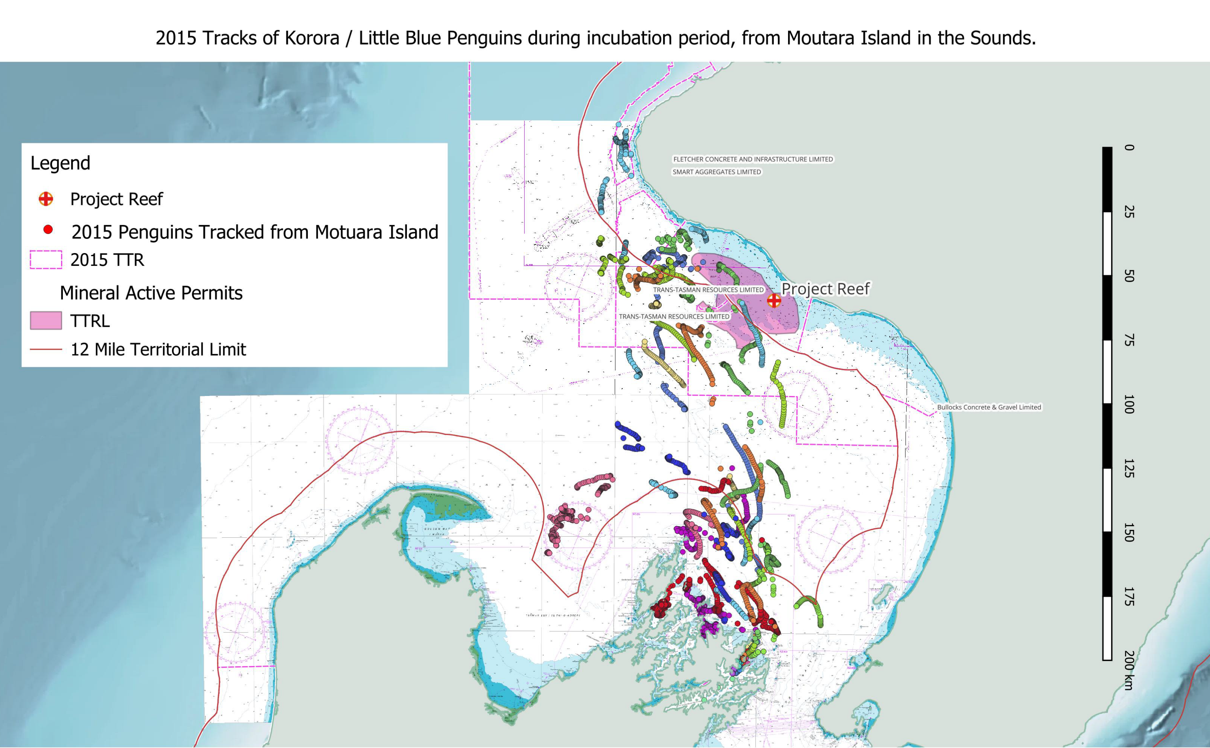
Please report footprints of any kororā in South Taranaki

Slide 21
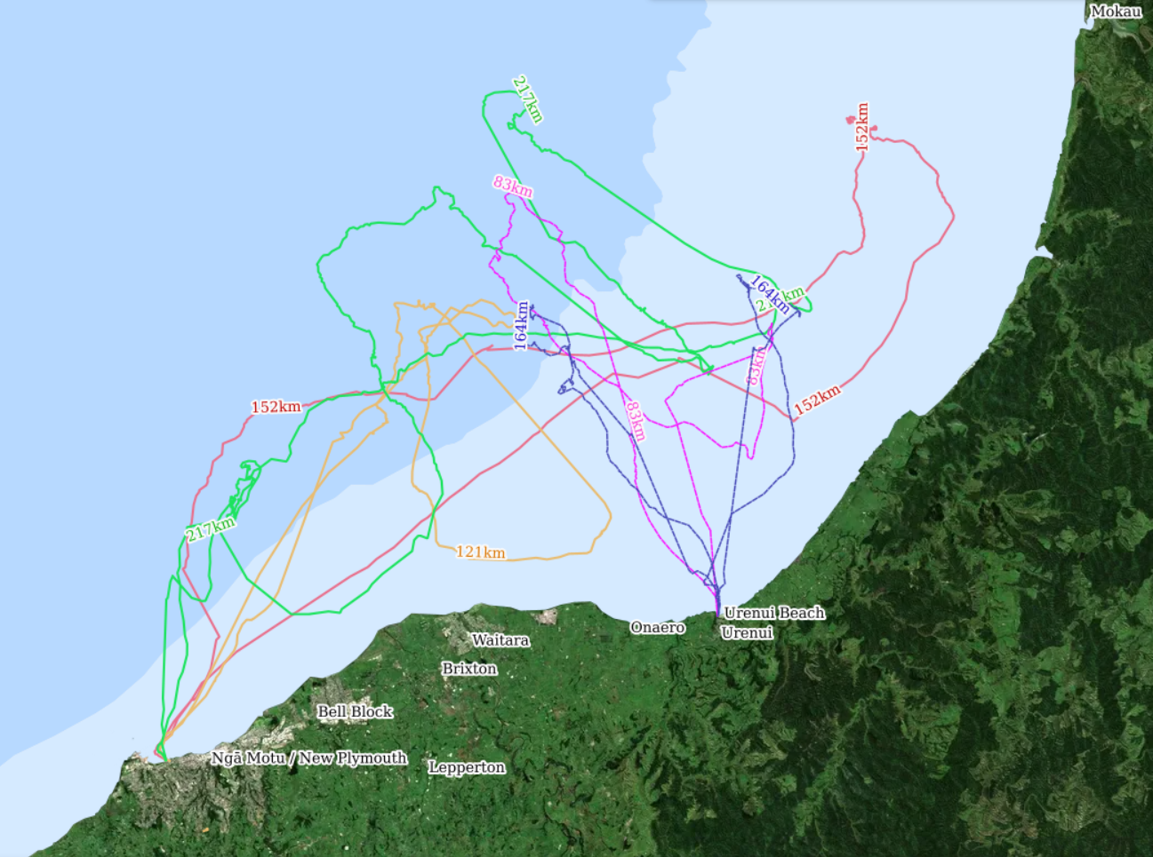
https://www.penguintracking.org/little-penguin/nga-motu/
2024 foraging tracks

Slide 22
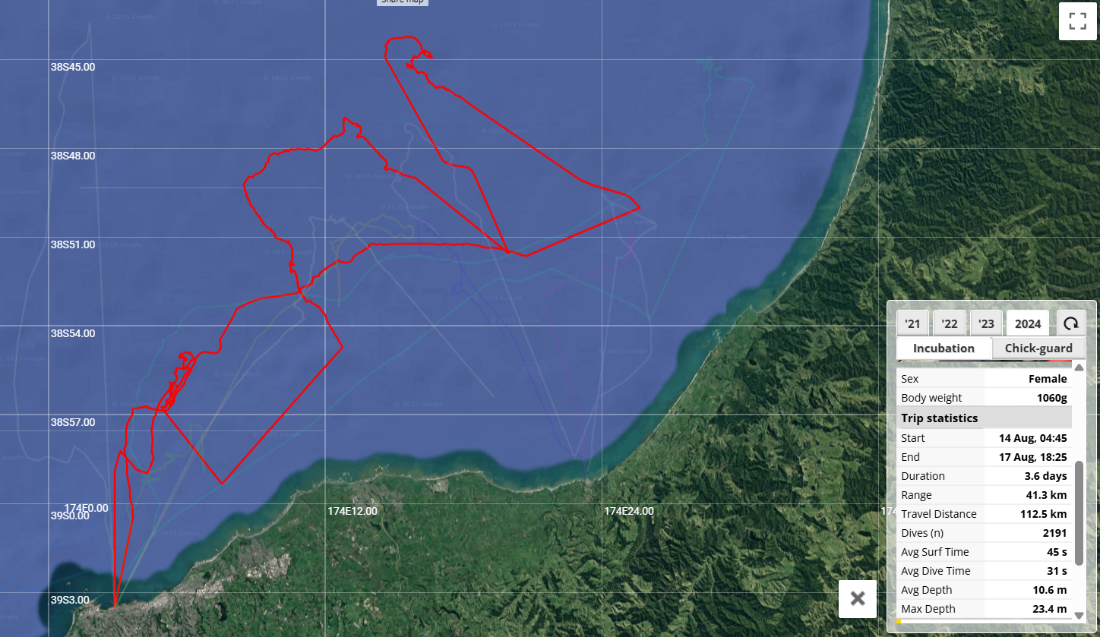
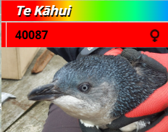
Bird 40087: 14-17th Aug 2024
Distance: 112.5km
Average depth: 10.6m
Max depth: 23.4m

Slide 23
Since 2021 using GPS tracking
63 complete foraging trips recorded
Only 3 of these had average dive depths of 2m or less
Median max dive depth per trip: 18.2 m (10.4 – 58.2 m)
Predation:
Opposite to TTR - predation risk is actually highest close to shore
TTR
Undertaken no on-land or at sea penguin monitoring

Slide 24
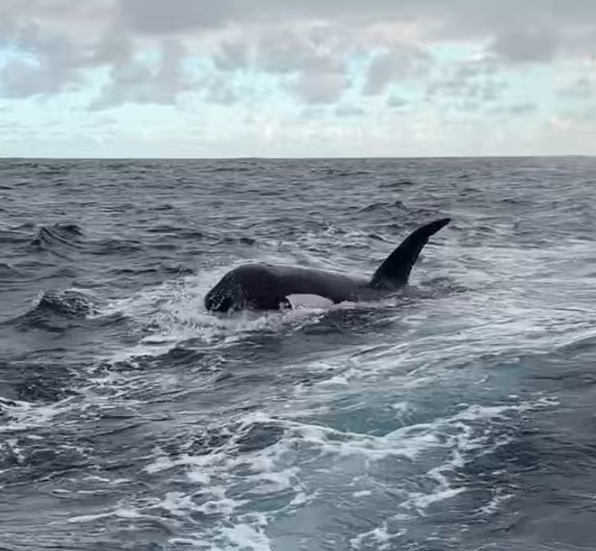
Orca
Threat status: Nationally critical
“Killer whales are rare visitors to the STB.”

Slide 25
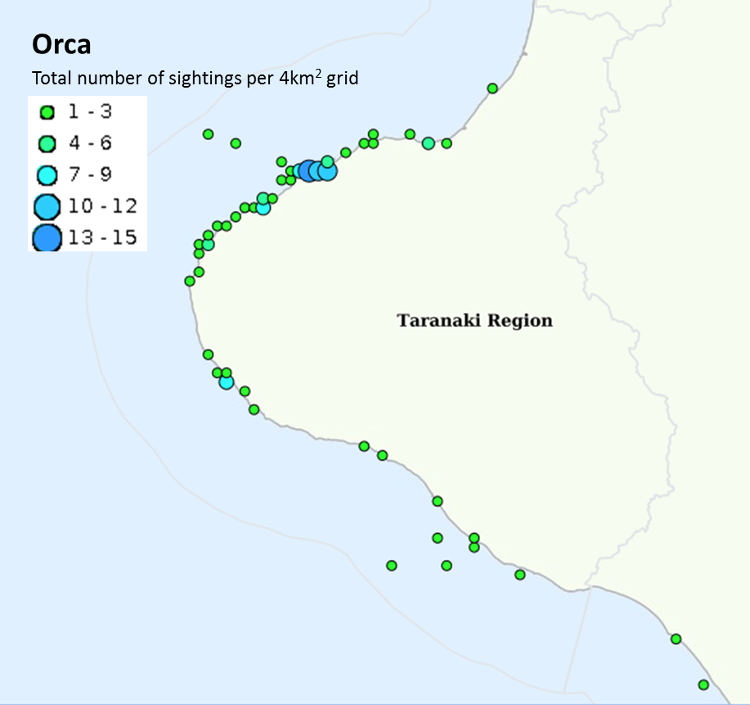
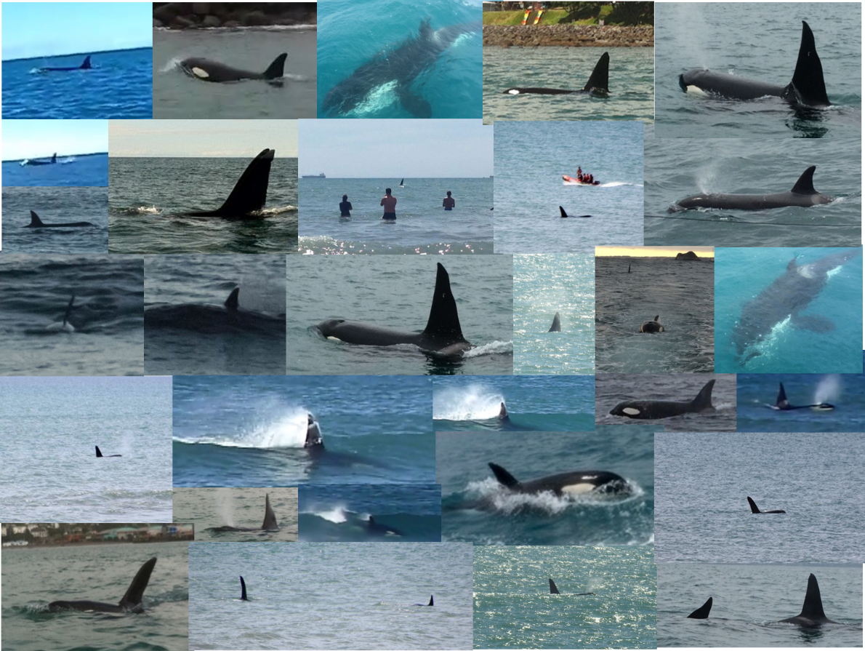
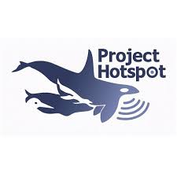
Orca
TTR 2016 application Taranaki: 6 orca sightings over 25 years
Project Hotspot Taranaki: 84 orca sightings 1 year, 29 different days
TTR 2025 application: Updated: 241 orca records South Taranaki Bight

Slide 26
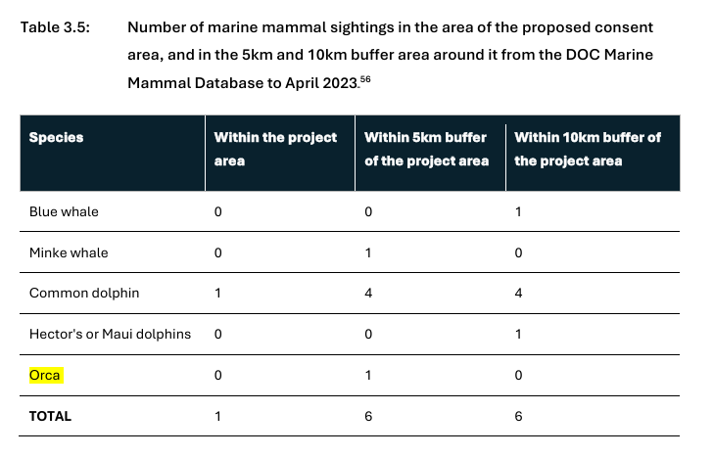
TTR:
“Killer whales are rare visitors to the STB.”
Based on no survey effort

Slide 27
Conclusion
The Ngāmotu Marine Reserve Society believes:
Ongoing evidence continues to highlight the TTRL application is not based on best available information
For seabirds and marine mammals:
To date no targeted standardised surveys
Species present, along with their ecology and behaviour, are not fully known
Until robust scientific research is carried out, it is not possible to assess the environmental effects of proposed activities

Slide 28
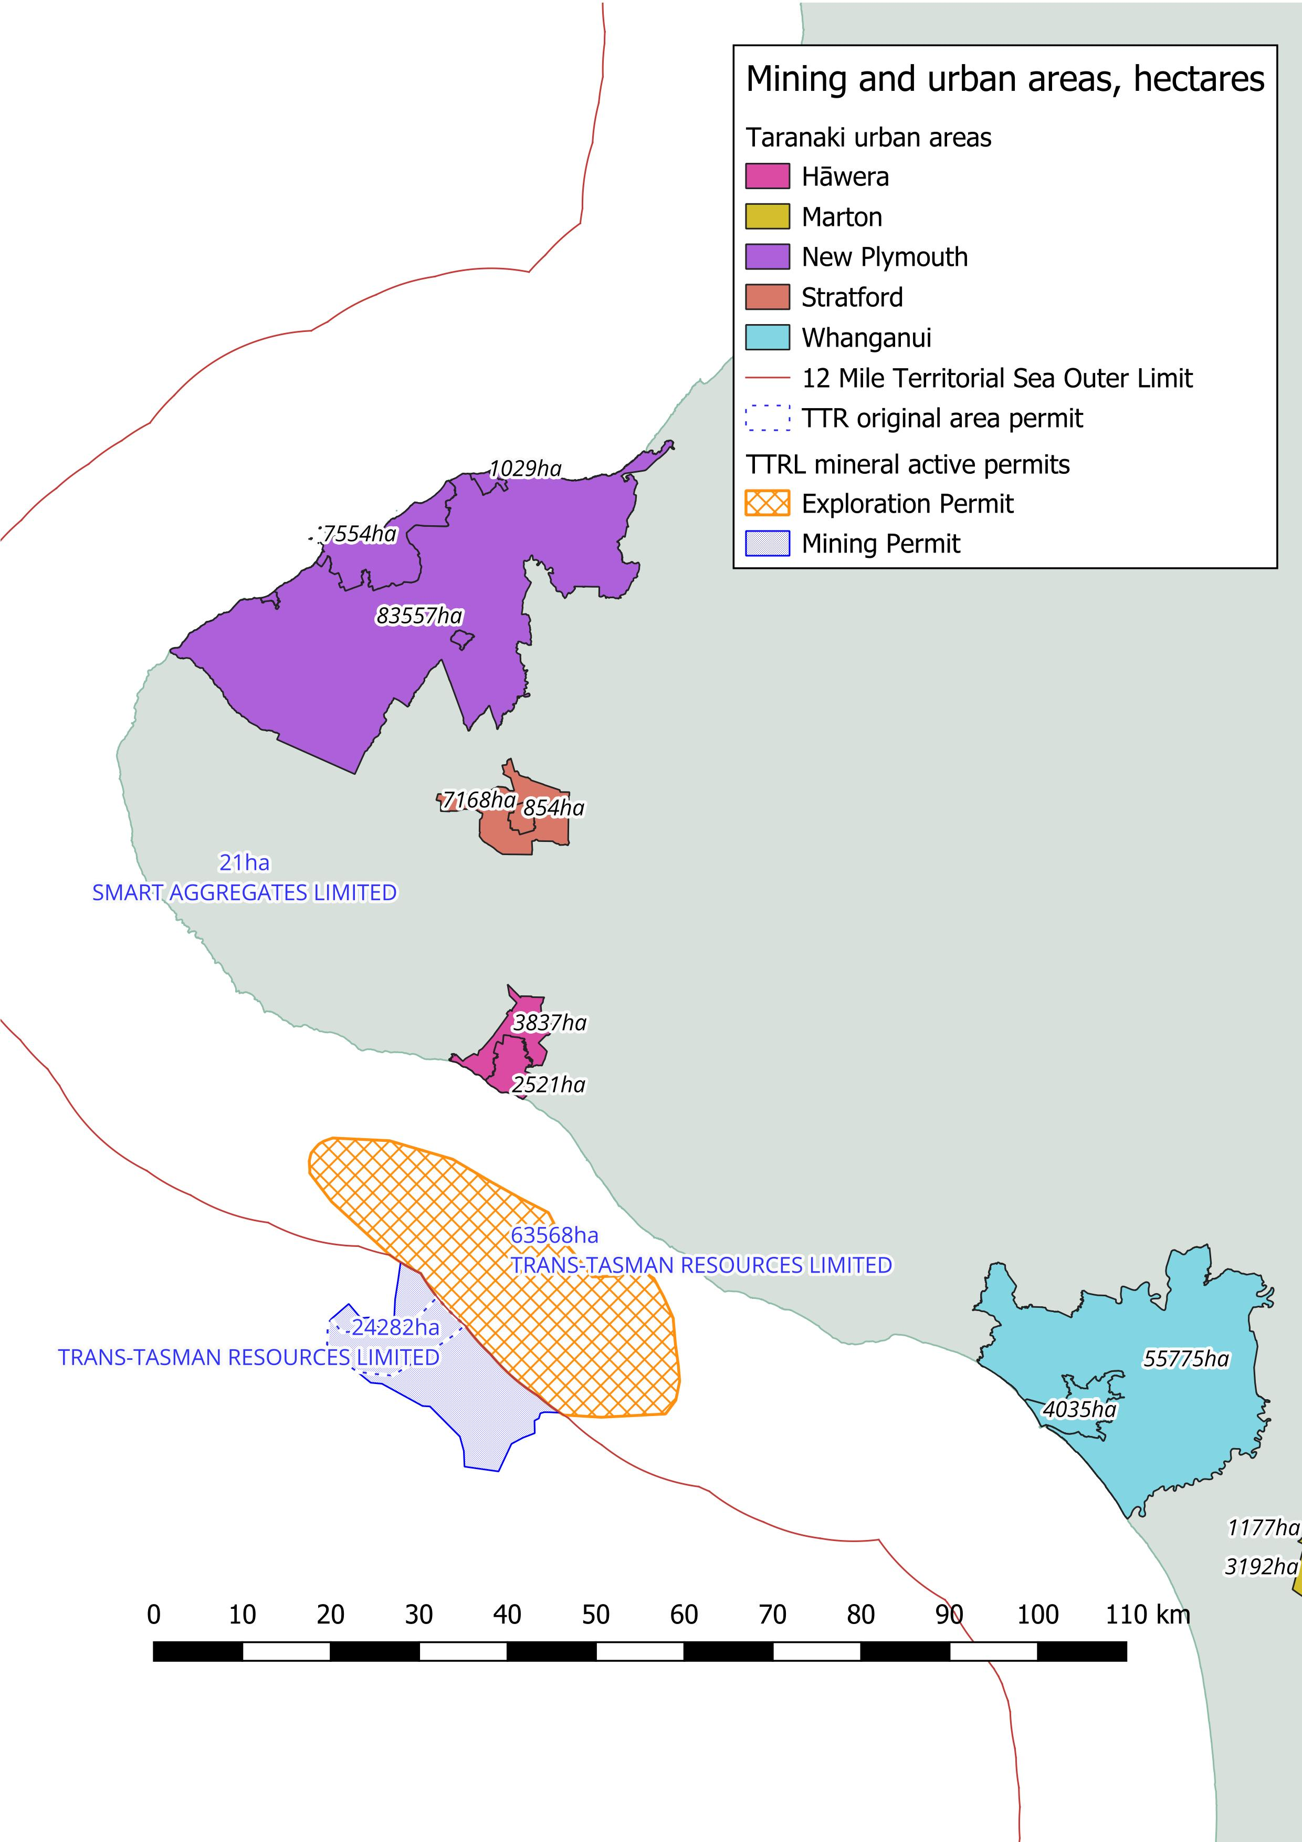

Slide 29
Does not:
Use the best available information
Safeguard the life-supporting capacity of the environment
Is not in line with:
Information principles: Exclusive Economic Zone Act (2012)
New Zealand Coastal Policy Statement (2010)
Coastal Plan for Taranaki (2023)
Decline this application

Slide 30
Ngā mihi nui
Photo credit

